Slide 1
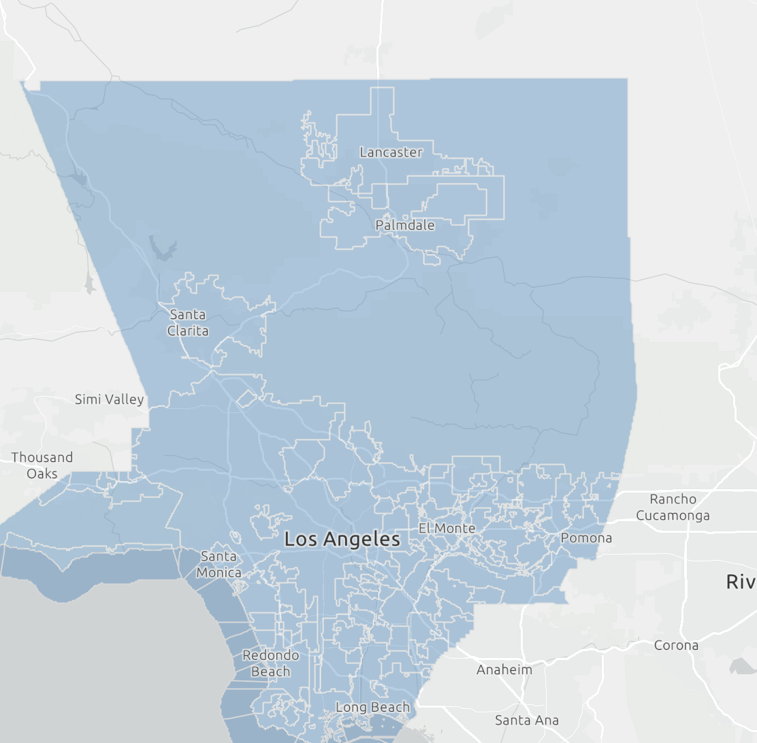

C700 DA-LA • OCTOBER 2026 MIDPROJECT: Indoor Air Quality Dataset
Indoor Air Quality in Los Angeles County
Environmental Justice, Pollutant Exposure, and Socioeconomic Sensitivity
RESEARCH TEAM
Cynthia Hernandez • Thomas Tran • Jazmine Gonzalez • Arshpreet Kaur • Jasmin Vela
📍 Los Angeles County Map
Notes:
My team has focused our data analysis skills on indoor air quality in Los Angeles County. We looked at communities that rank in the top 10% for IAQ sensitivity. What stands out is that these are rarely communities facing just one problem. They tend to carry several burdens at once.”

Slide 2




RESEARCH TEAM
Meet the Data Analyst Team
CH
Cynthia Hernandez
COOP Fellow
TT
Thomas Tran
COOP Fellow
JG
Jazmine Gonzalez
COOP Fellow
Arshpreet Kaur
COOP Fellow
JV
Jasmin Vela
COOP Fellow

Slide 3
PROJECT ARCHITECTURE
The Analytical Framework
PHASE 01
PHASE 02
PHASE 03
PHASE 04
Insights & Visuals
Implications
Ideas & Impact
Inquiries
90th percentile baseline data.
Socioeconomic and health risks.
Targeted community solutions.
Longitudinal data exploration.

Slide 4


BACKGROUND & PURPOSE
Landscape Background & Objective
01 • Background
02 • OBJECTIVE
10M Estimated LA County Population
Largest county in California
Environmental Factor
Indoor Air Quality Exposure
Disparities in air quality affect millions across various municipal jurisdictions.
Key Research Question
Which counties, cities, or unincorporated areas are the most affected?
Analytical Focus
LA County 90th Percentile Indoor Quality Index
Identifying which populations within LA County are most severely impacted and quantifying the long-term health and socioeconomic burdens.

Slide 5
CONTEXT & SCOPE
Problem Statement & Research Questions
Questions
Why do certain areas in LA have poor indoor air quality?
Which communities in Los Angeles County are most sensitive to indoor air quality, and what pollution, socioeconomic, housing, and health factors overlap in those communities?
ANALYSIS BASELINE
246
High-Risk Communities
Geography: Los Angeles County
Baseline: 90th-percentile IAQ sensitivity; 246 high-risk communities, as identified in our current analysis
Measures: Pollutant indicators, population health, housing, and socioeconomic factors
Approach: Compare community-level patterns and overlapping indicators to identify areas for further investigation.
Focusing on the 90th percentile of IAQ sensitivity across LA County.
Notes:
Exposure to air pollutants can pose risks to community health.
Socioeconomic disadvantages may make environmental challenges harder to address.

Slide 6
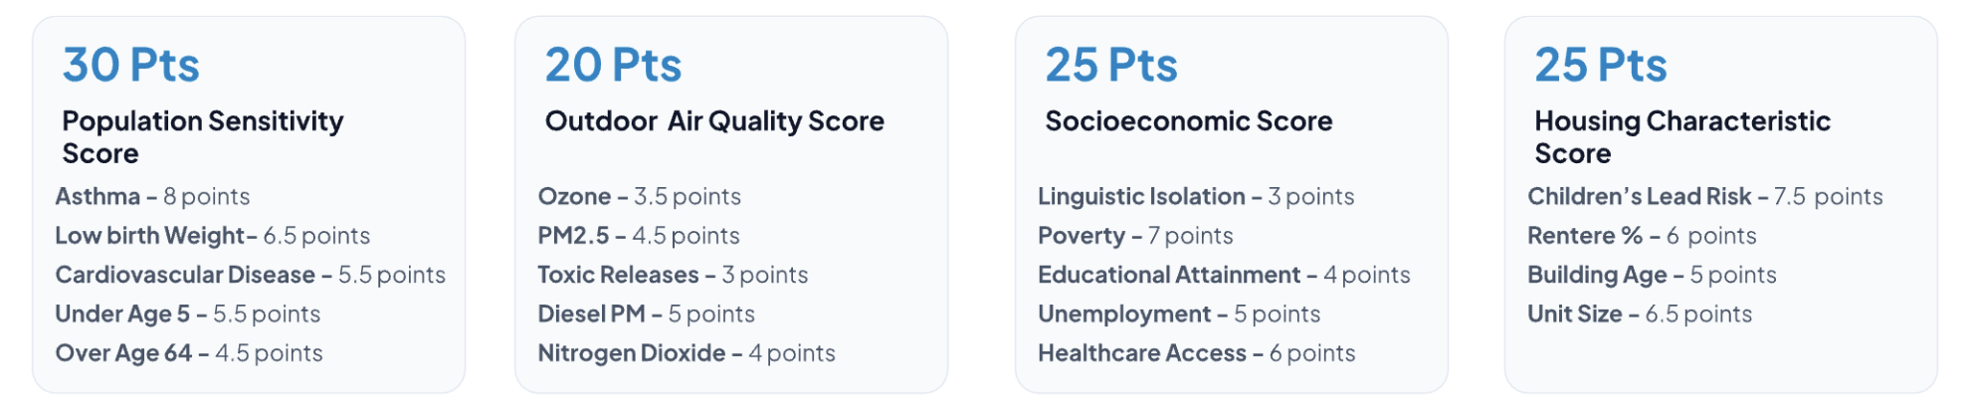
SCORING ARCHITECTURE
Indoor Air Quality Sensitivity Index (100 Points)
30 Pts
20 Pts
25 Pts
25 Pts
Population Health
Outdoor Air
Socioeconomics
Housing Stock
Asthma and cardiovascular risks.
PM2.5, diesel, and NO₂ levels.
Poverty and healthcare barriers.
Building age and lead risk.

Slide 7
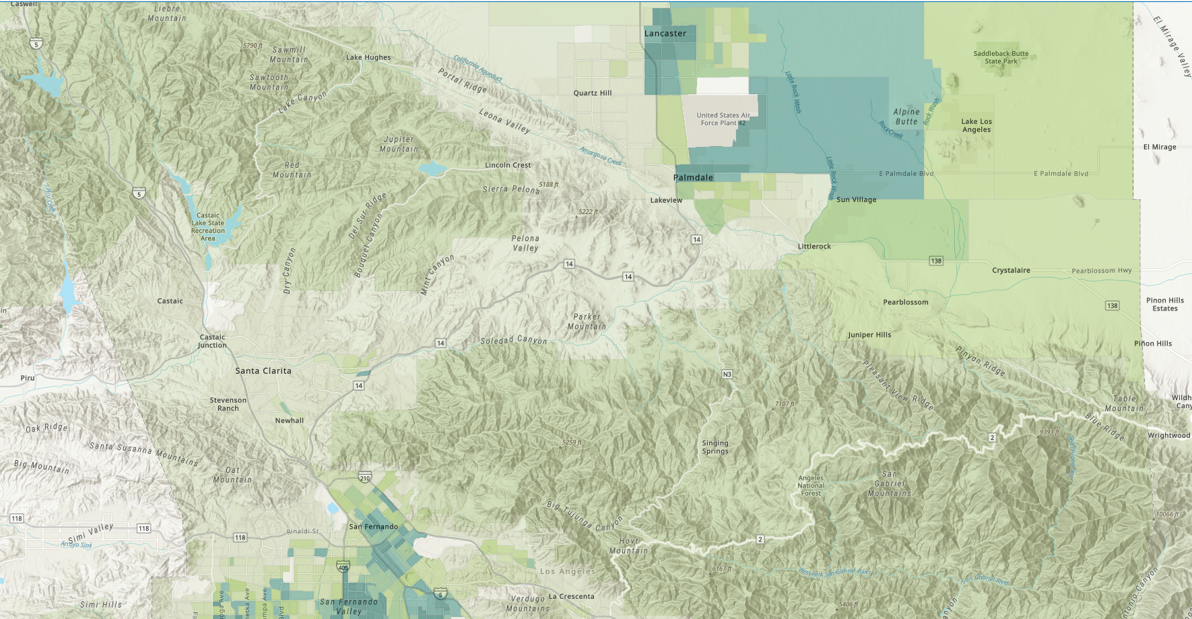
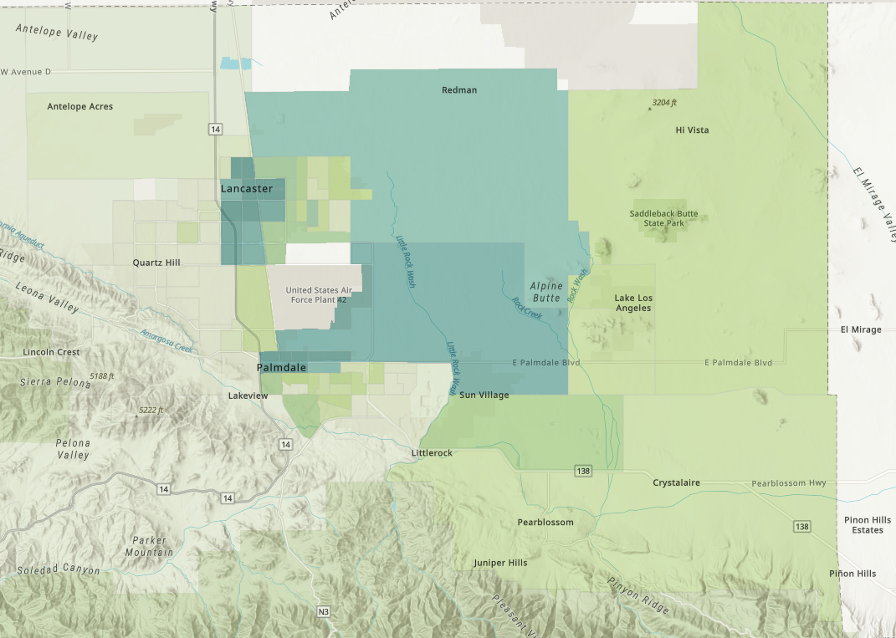
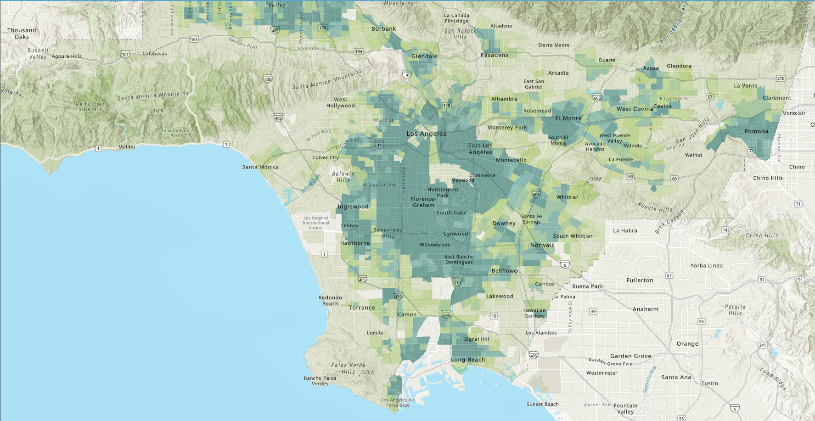
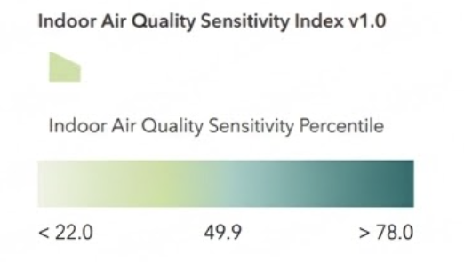
Map of Los Angeles County with areas indicating their IAQ sensitivity percentile
Notes:
This map provides an overview of where sensitivity is concentrated and helps us identify communities that may need closer attention when discussing environmental justice and public health.

Slide 8
CONTEXT & SCOPE
Indoor Air Quality Is an Environmental Justice Issue
Communities across Los Angeles County may face overlapping environmental, socioeconomic, and health challenges that increase their vulnerability to poor air quality. Understanding IAQ sensitivity at the community level can help public agencies and community organizations make more informed decisions
Primary Stakeholder
United Nations
Stakeholders
Department of Economic and Social Affairs
Local public health agencies, environmental agencies, and community organizations
Sustainable Development
Notes:
These stakeholders can use community-level data to identify areas for further assessment and inform environmental health initiatives. Indoor air quality is not just an environmental concern; it can also be an environmental justice issue. Communities across Los Angeles County may face overlapping environmental, socioeconomic, and health challenges that increase their vulnerability to poor air quality.
The purpose of this project is to better understand indoor air quality sensitivity at the community level and how it may overlap with other factors.
Our findings may help local public health agencies, environmental agencies, and community organizations make more informed decisions about where further investigation and support may be needed.
This topic also connects to the United Nations Department of Economic and Social Affairs and the broader goals of sustainable development. Ultimately, understanding which communities may be more vulnerable can help inform efforts toward healthier and more equitable living environments.

Slide 9
Key Findings & Data Analysis
Exploring the spatial distribution of indoor air quality indicators and compound environmental burdens across Los Angeles County communities.
Notes:
In this analysis, we will explore how high Indoor Air Quality Sensitivity Scores overlap with factors that can make communities more vulnerable, including pollutants, poverty, housing and health.

Slide 10
Insight #01
Pollutants
Analyst: Cynthia
Notes:
I will be going over pollutants in communities and how other factors

Slide 11
DATA INSIGHTS • CYNTHIA'S ANALYSIS
90th Percentile Pollutant Exceedances (n=246)
Nitrogen Dioxide (NO₂)
99 Communities
PM2.5 Fine Particulate
78 Communities
Diesel Particulate Matter
42 Communities
Facility Toxic Releases
31 Communities
Ground-Level Ozone
1 Community
Notes:
From the communities that had high Indoor Air Quality Sensitivity Scores, we wanted to look at how many of them had high-level of pollutants. Within our 246 communities we found nitrogen dioxide to be elevated for 99 communities followed by PM2.5 for 78 communities, then diesel particulate matter for 42 communities, facility toxic releases for 31 communities and only 1 community had a high-level for ground-level ozone.

Slide 12
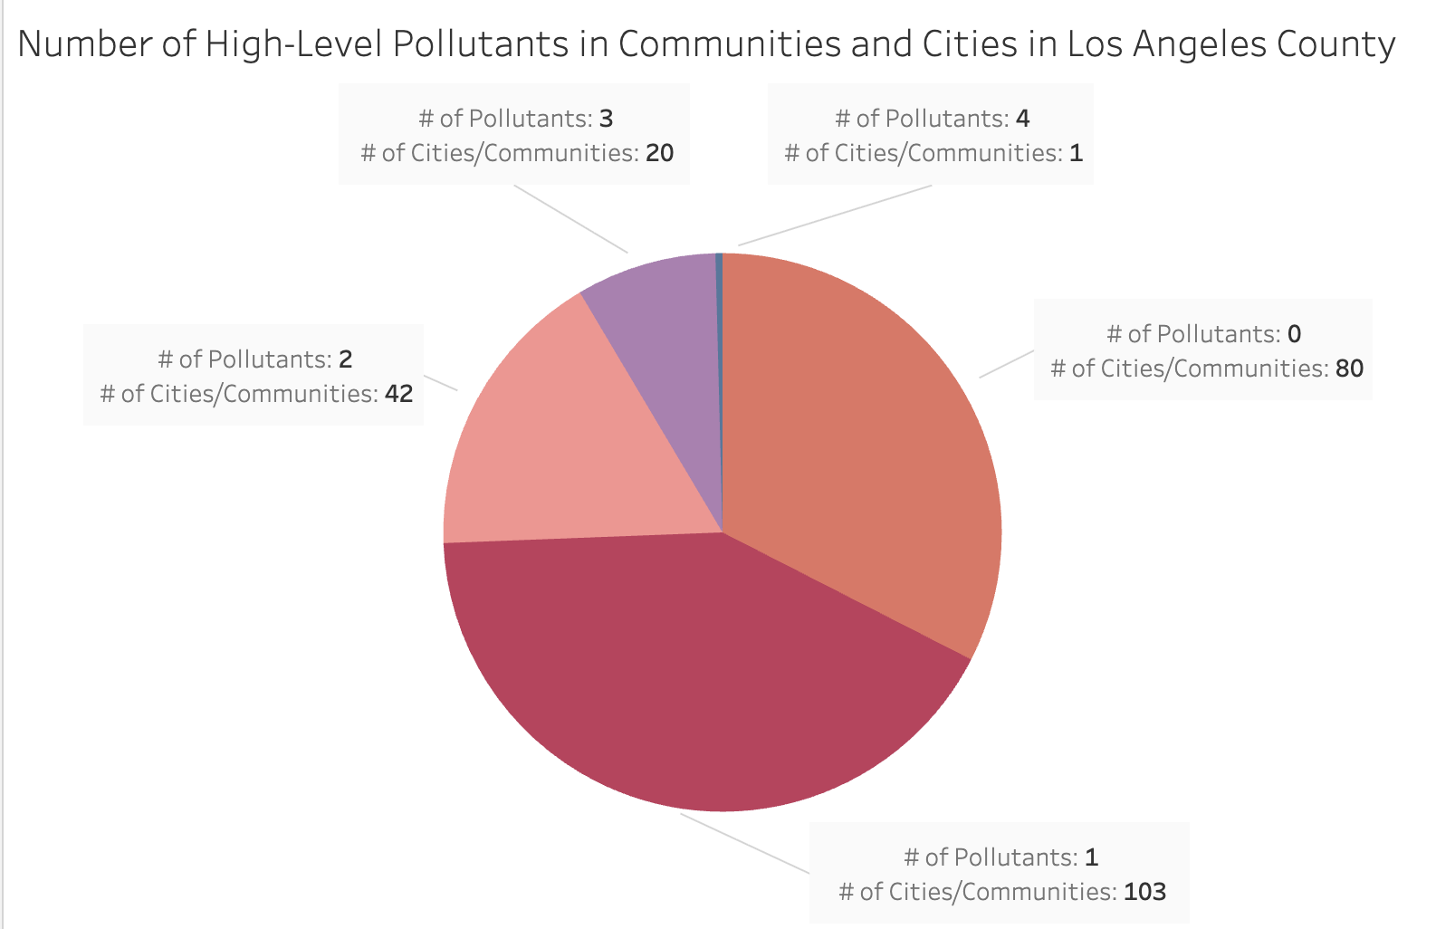
DATA INSIGHTS • CYNTHIA'S ANALYSIS
90th Percentile Pollutant Exceedances (n=246)
Hotspot Insight: City of Compton leads all areas with 4 overlapping pollutant cutoffs exceeded.
Notes:
After looking at how many communities had a high level of pollutants we wanted to look at how many communities had multiple pollutants at a high level. Here we found that 80 of the communities actually had none, 103 of them had 1, 42 of them had 2, 20 had 3, and only 1 of them had 4.
Overall, 63 communities had more than one pollutant at a high level, but most had only one or none, so overlapping pollutant exposure is concentrated in a small group of communities, with Compton at the top

Slide 13
SOCIOECONOMIC CONVERGENCE
Environmental Burden Meets High Poverty
89 Compounded Communities
52.4%
Face both severe air pollution and acute poverty rates.
High-Poverty Communities
Over half of sensitive tracts exceed the 64.6% poverty cutoff.
Vermont Vista Hotspot
Highest combined poverty rate and sensitivity index in LA.
Notes:
After looking at the pollutants, we wanted to connect them to other factors, starting with poverty. Nearly 52.4% of the high-sensitivity communities were in high poverty. When we looked at the communities with at least one high pollutant, 89 of 166 were also in high poverty. Los Angeles was the leading city, and Vermont Vista was the highest-poverty community.
Overall, poverty and high pollutant levels often occur in the same communities and demonstrate overlap.
After analyzing poverty, i will pass it on to arsh who will talk about other socioeconomic factors.

Slide 14
INSIGHT #02
Education & Unemployment
Analyst: Arsh
Notes:
Are communities experiencing poorer air quality also more likely to experience socioeconomic disadvantages?

Slide 15
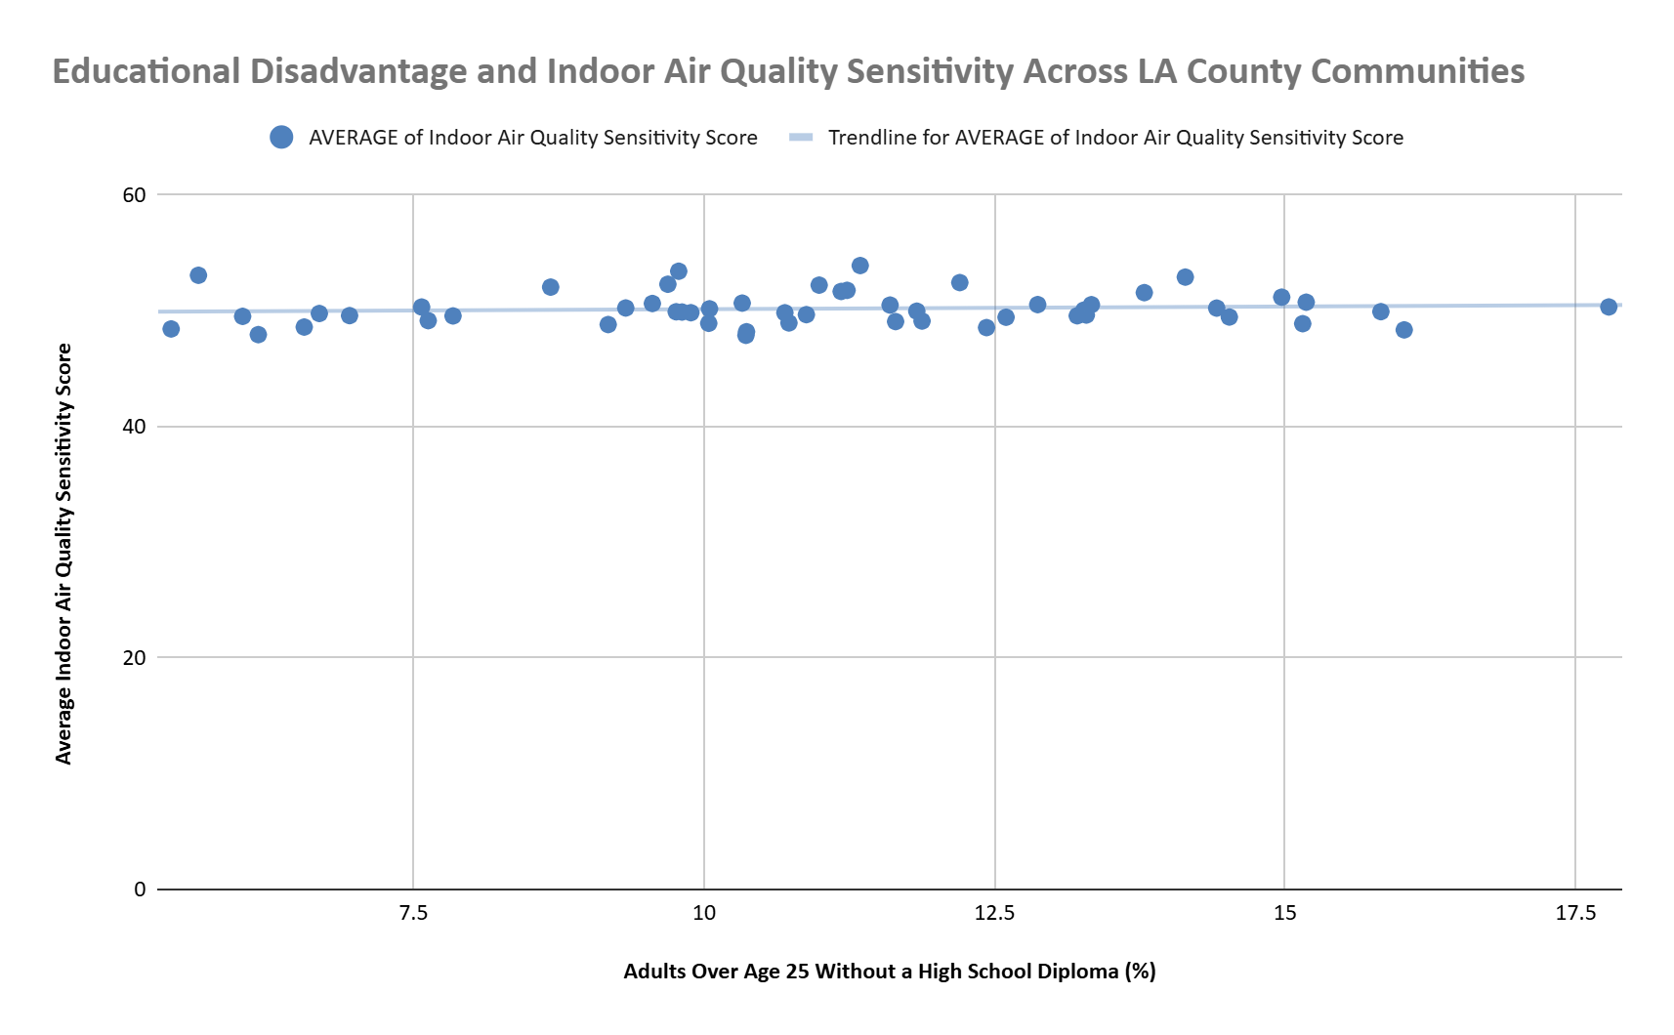
DATA INSIGHTS • SOCIOECONOMIC ANALYSIS
Do communities with higher educational disadvantage also tend to have higher IAQ sensitivity?
Trend Direction
Flat trendline with widely scattered points suggests weaker association
Each dot represents one community/observation.
Educational disadvantage
measured as the percentage of adults over age 25 without a high school diploma
Percentiles
represent relative rankings across Los Angeles County census tracts
Notes:
For this first visualization, I wanted to explore whether communities with higher educational disadvantage also tend to have higher indoor air quality sensitivity. We measured educational disadvantage by looking at the percentage of adults over 25 who do not have a high school diploma. Each dot represents a community or observation, and the percentiles show how communities rank compared to others across Los Angeles County.
As we can see, the points are widely scattered, and the trendline is relatively flat. This suggests that there is a weak association between educational disadvantage and IAQ sensitivity in this analysis. In other words, a community having a higher level of educational disadvantage does not necessarily mean it will also have a higher IAQ sensitivity ranking. This tells us that we need to consider multiple factors when examining community vulnerability.

Slide 16
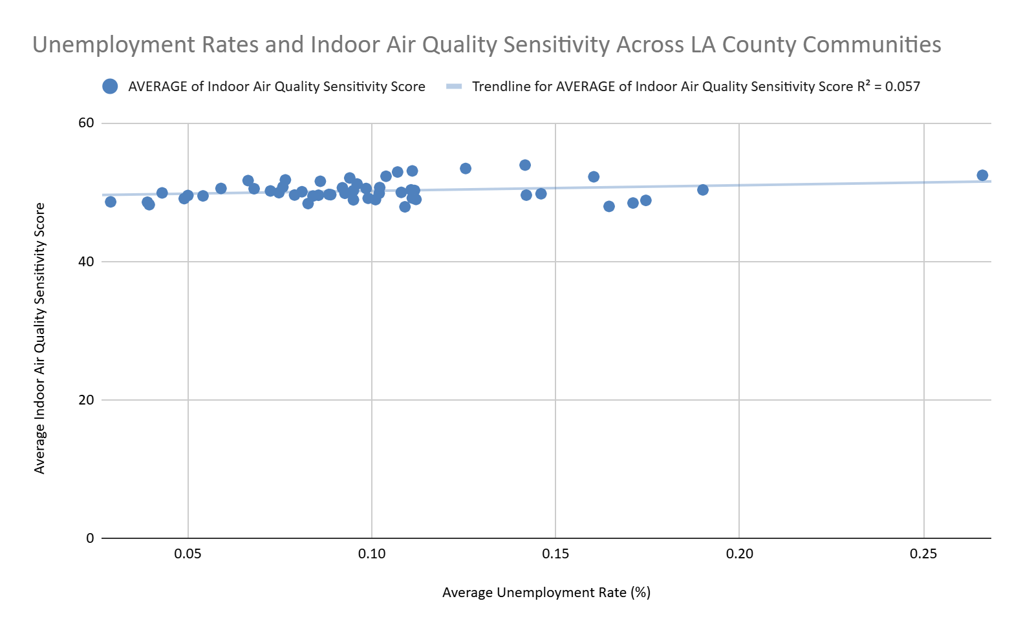
DATA INSIGHTS • SOCIOECONOMIC ANALYSIS
Do communities with higher unemployment rates also tend to have higher IAQ sensitivity?
Trend Direction
Flat trend line with scattered points leaning toward 10% average unemployment rate
Each dot represents one community/observation.
Discrepancy
Willowbrook has the highest average unemployment rate of 27%
Percentiles
represent relative rankings across Los Angeles County census tracts
Notes:
For the second visualization, I looked at whether communities with higher unemployment rates also tend to have higher indoor air quality sensitivity. Similar to the previous chart, the points are scattered around a relatively flat trendline, which suggests that there is not a strong relationship between these two measures in our analysis.
One community that stands out is Willowbrook, which has the highest average unemployment rate in this comparison at 27%. This is an important example to examine when looking at overlapping socioeconomic and environmental challenges. However, we cannot assume that every community with high unemployment will also have high IAQ sensitivity. Instead, this finding reinforces the importance of looking at individual communities and considering other factors that may contribute to their vulnerability.

Slide 17
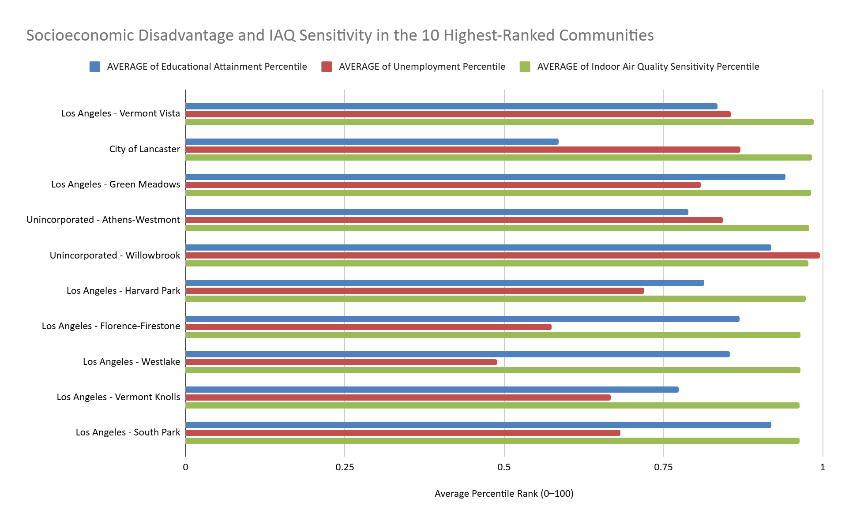
DATA INSIGHTS • SOCIOECONOMIC ANALYSIS
Which communities have relatively high educational disadvantage, unemployment, and IAQ sensitivity at the same time?
Highest Rankings
Vermont Vista, Willowbrook,
Green Meadows
have all three factors very high, each passing the 80th percentile ranking
Lancaster: A mixed ranking pattern
Educational dis.: 59th percentile
Unemployment: 87th percentile
IAQ sensitivity: 98th percentile
High IAQ sensitivity does not always coincide with equally high rankings across every socioeconomic measure.
Notes:
I compared the relative percentile rankings of educational disadvantage, unemployment, and IAQ sensitivity across communities. The percentiles show how each community ranks relative to other census tracts in Los Angeles County, rather than representing actual percentages of people experiencing a condition.
Vermont Vista, Willowbrook, and Green Meadows stand out because they rank highly across multiple measures, showing how socioeconomic disadvantage and IAQ sensitivity can overlap. However, the rankings are not consistent for every community.
For example, Lancaster has an IAQ sensitivity percentile of about 98 and an unemployment percentile of about 87, but its educational disadvantage percentile is around 59. This suggests that a community can rank very high in IAQ sensitivity without ranking equally high across every socioeconomic measure. Athens-Westmont and Harvard Park also show differences between their education and unemployment rankings, although the gaps are smaller.
This mixed ranking pattern is an important insight because it shows why we should not rely on a single socioeconomic indicator to identify communities for further investigation. Instead, looking at multiple measures together gives us a more complete picture of potential vulnerability. These rankings show overlap and differences, but they do not explain what causes those patterns.

Slide 18
INSIGHT #03
Housing
Analyst: Thomas

Slide 19
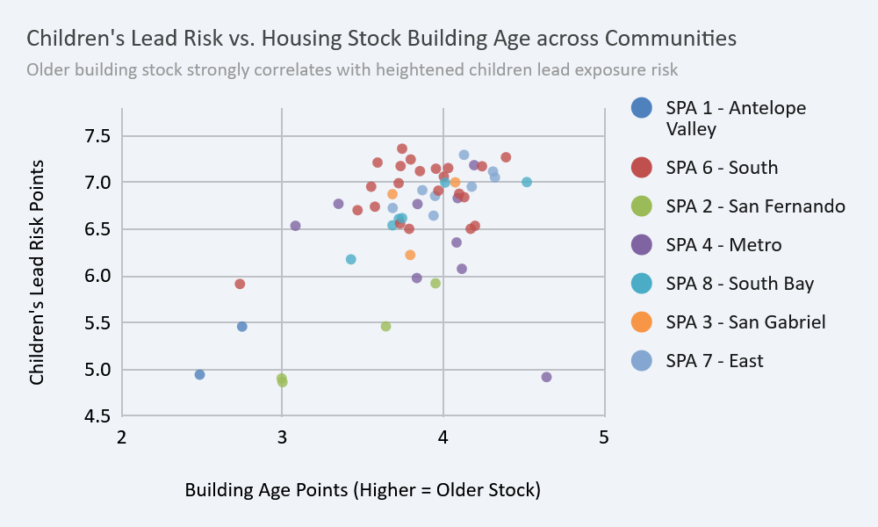
DATA INSIGHTS • HOUSING CHARACTERISTIC SCORE
Children’s Lead Risk compared to Unit Age
Older = More Risk
Clear correlation between older building scores and Children’s Lead Risk.
Highest Regional Scores
SPA 6 (South) (7.02)
SPA 7 (East) (7.00)
Newer Housing Stock
SPA 2 (San Fernando) (5.27)
SPA 1 (Antelope Valley) (5.33)
Notes:
There is a strong positive correlation between Building Age Points and Children’s Lead Risk Points across LA County Communities. Older residential structures are the main determinant of elevated lead exposure risk for children. SPA 6 (South) and SPA 7 (East) have the highest regional Children's Lead Risk scores at 7.02 and 7.00 respectively, whereas newer housing stock in SPA 2 (San Fernando) and SPA 1 (Antelope Valley) yields significantly lower lead risk scores (5.27 and 5.33).

Slide 20
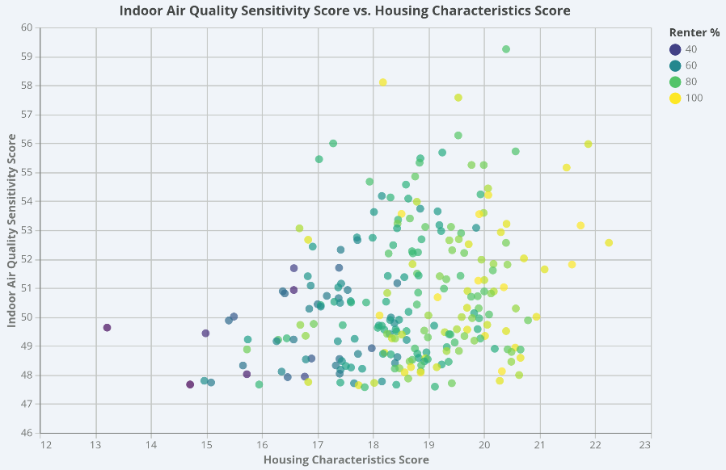
DATA INSIGHTS • HOUSING CHARACTERISTIC SCORE
Renter % Data
Notes:
There is a strong positive correlation between Building Age Points and Children’s Lead Risk Points across LA County Communities. Older residential structures are the main determinant of elevated lead exposure risk for children. SPA 6 (South) and SPA 7 (East) have the highest regional Children's Lead Risk scores at 7.02 and 7.00 respectively, whereas newer housing stock in SPA 2 (San Fernando) and SPA 1 (Antelope Valley) yields significantly lower lead risk scores (5.27 and 5.33).

Slide 21
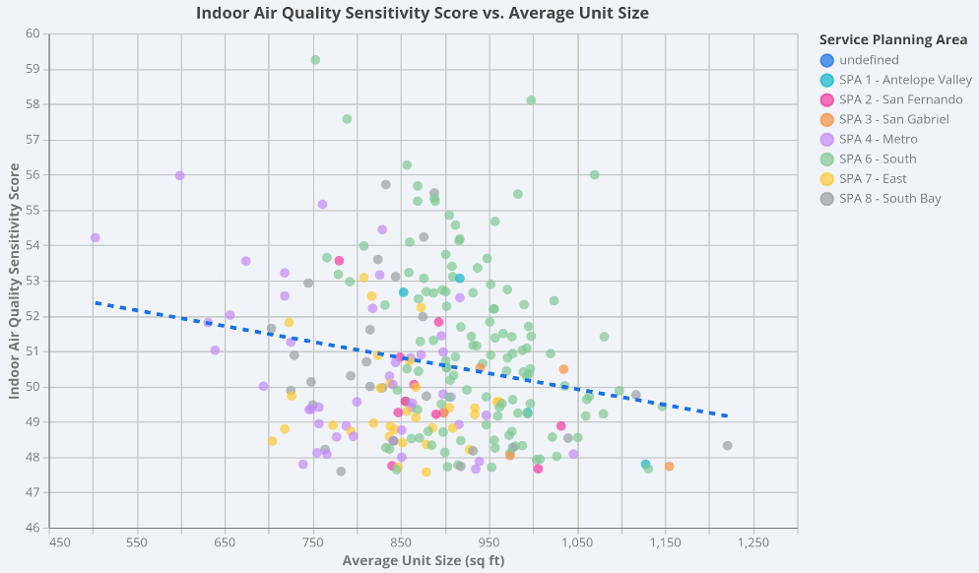
DATA INSIGHTS • HOUSING CHARACTERISTIC SCORE
More Space, More Problems?
Larger Average = Lower Score
Notable Service Planning Areas
SPA 6 - South
SPA 4 - Metro
Notes:
Unit Size in the data set is measured by number of units on property per total livable square footage on property.

Slide 22
INSIGHT #04
Access to Healthcare
Analyst: Jazmine G.

Slide 23
Jazmine Insights: HEALTH & VULNERABILITY ANALYSIS
Uninsured Effects & Clinical Vulnerability
BENCHMARK DATA
Uninsured
246/296 90th Percentile IAQ
68% communities
90th Percentile Uninsured
A higher score or percentile reflects worse access and greater vulnerability.
Asthma & Cardiovascular Disease (CVD)
Respiratory and circulatory conditions aggravated by airborne particulates and mold. Comparing these against uninsured rates identifies communities where clinical management of chronic symptoms is least accessible.
Low Birth Weight
A sensitive marker for maternal exposure to environmental contaminants and inadequate prenatal care within vulnerable census tracts.
Children Under Age 5 & Adults Over Age 64
Physiologically vulnerable age groups requiring frequent primary and emergency care when air quality triggers severe respiratory distress.
Notes:
“In these top-decile communities, we frequently see severe asthma and elevated cardiovascular disease risk together. So indoor air quality isn’t an isolated issue. It lands on populations that are already health-burdened.
Top Impacted Neighborhoods: As illustrated in the "Top Communities by Cardiovascular Disease Risk in High-IAQ Areas" chart, several neighborhoods experience extreme cardiovascular risk scores alongside high environmental sensitivity:
Century Palms/Cove (Los Angeles): 99.6th percentile CVD risk, 97.0th percentile Asthma, and 95.3rd percentile IAQ sensitivity.
Figueroa Park Square (Los Angeles): 99.3rd percentile CVD risk, 96.0th percentile Asthma, and 93.0th percentile IAQ sensitivity.
Willowbrook (Unincorporated County): 99.2nd percentile CVD risk, 95.1st percentile Asthma, and 97.8th percentile IAQ sensitivity.
Watts (Los Angeles): 98.7th percentile CVD risk, 95.7th percentile Asthma, and 96.2nd percentile IAQ sensitivity.

Slide 24
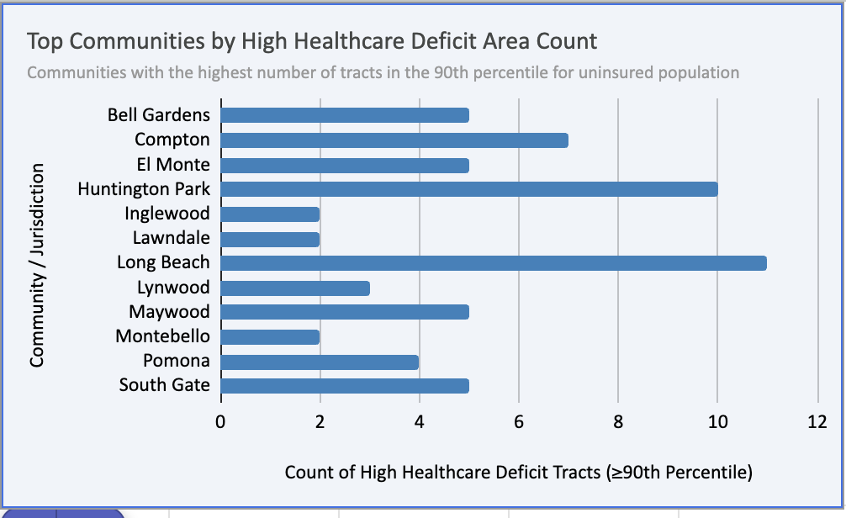
DATA INSIGHTS • HEALTHCARE ACCESS
Graph: Highest Percentile Cities & Communities (Uninsured 90th Percentile)
ANALYSIS OVERVIEW
Health Access Intersection
Examining the number of cities within LA County that are in the 90th indoor air quality sensitivity percentile and have the highest percentile of uninsured population.
246
Communities Analyzed
Distinct cities & unincorporated communities across LA County
Top Communities by High Healthcare Deficit Area Count
Notes:
Primary Concentration Areas: The "Top Communities by High Healthcare Deficit Area Count" chart highlights the cities with the greatest number of severely impacted census tracts:
Long Beach: 11 tracts in the highest uninsured bracket.
Huntington Park: 10 tracts.
Compton: 7 tracts.
South Gate, El Monte, Maywood, and Bell Gardens: 5 tracts each.

Slide 25
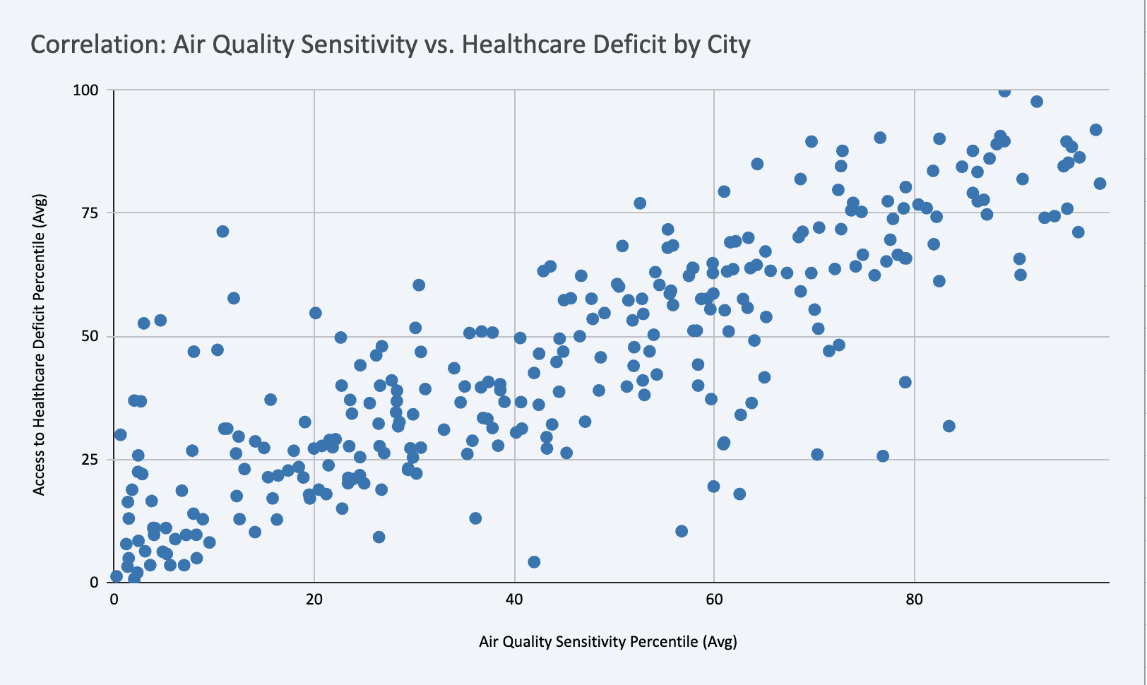
DATA INSIGHTS • CORRELATION ANALYSIS
Air Quality Sensitivity vs. Healthcare Deficit
KEY FINDINGS
Positive Trend Identified
The scatter plot demonstrates a direct relationship between environmental vulnerability and health care access barriers across analyzed municipalities.
TAKEAWAY
The higher the air quality sensitivity percentile, the higher the percentile of healthcare inaccessibility.
Communities facing severe air quality issues simultaneously suffer from significant healthcare infrastructure deficits.
Notes:
2. The pattern
“In these top-decile communities, we frequently see severe asthma and elevated cardiovascular disease risk together. So indoor air quality isn’t an isolated issue. It lands on populations that are already health-burdened.”
4. Healthcare access
“In this scatter plot : healthcare access correlation with the AQI. Communities with large healthcare access deficits also tend to have elevated asthma and cardiovascular risk to which my fellow analyst will That combination may compound the impact of indoor air pollution on the people living there, because the residents who are most exposed also have the hardest time getting care.”

Slide 26
INSIGHT #05
Asthma Vulnerability
Analyst: Jasmin V.

Slide 27
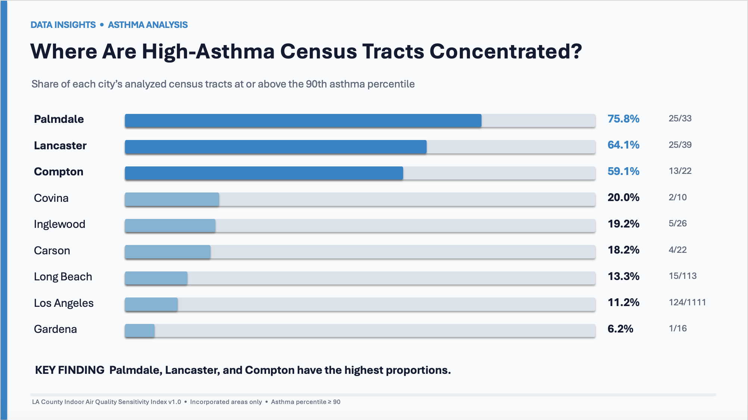

Slide 28
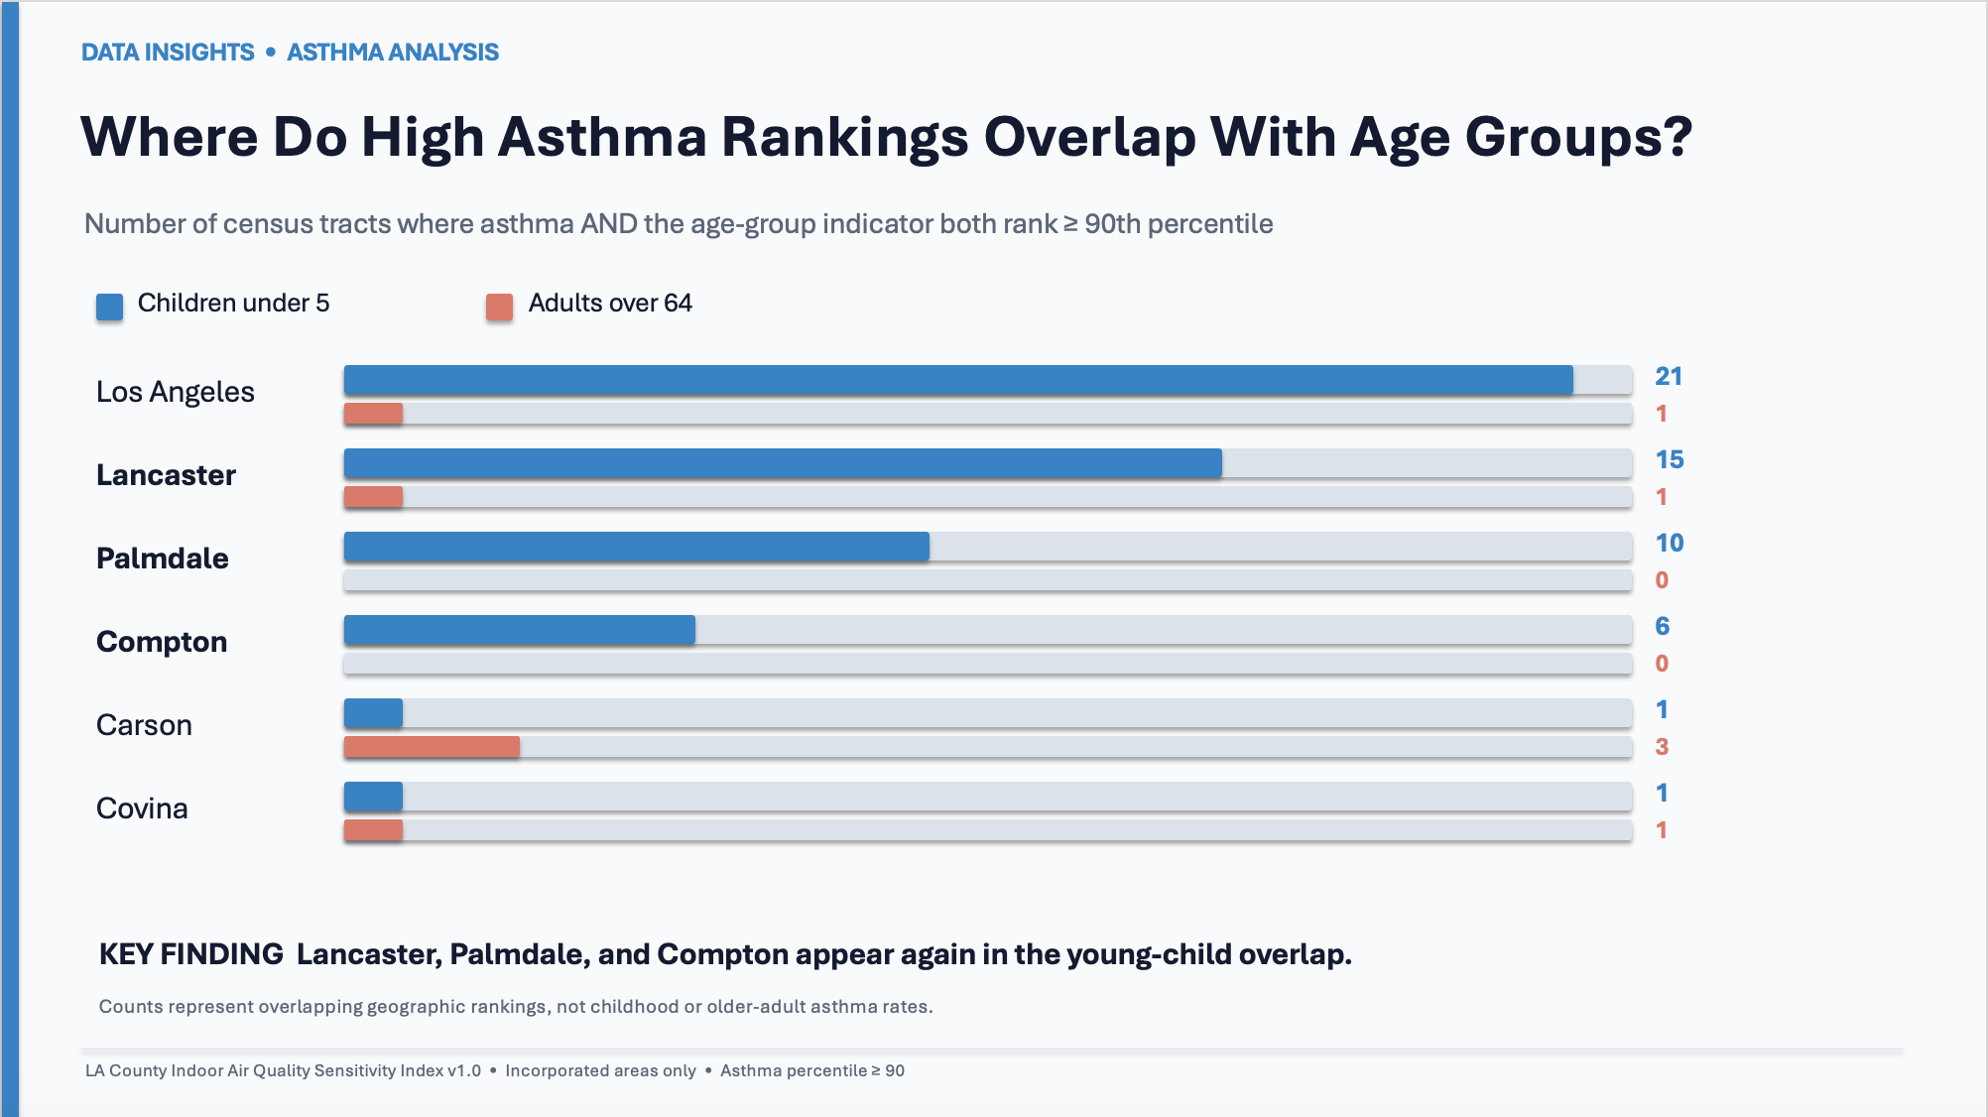

Slide 29
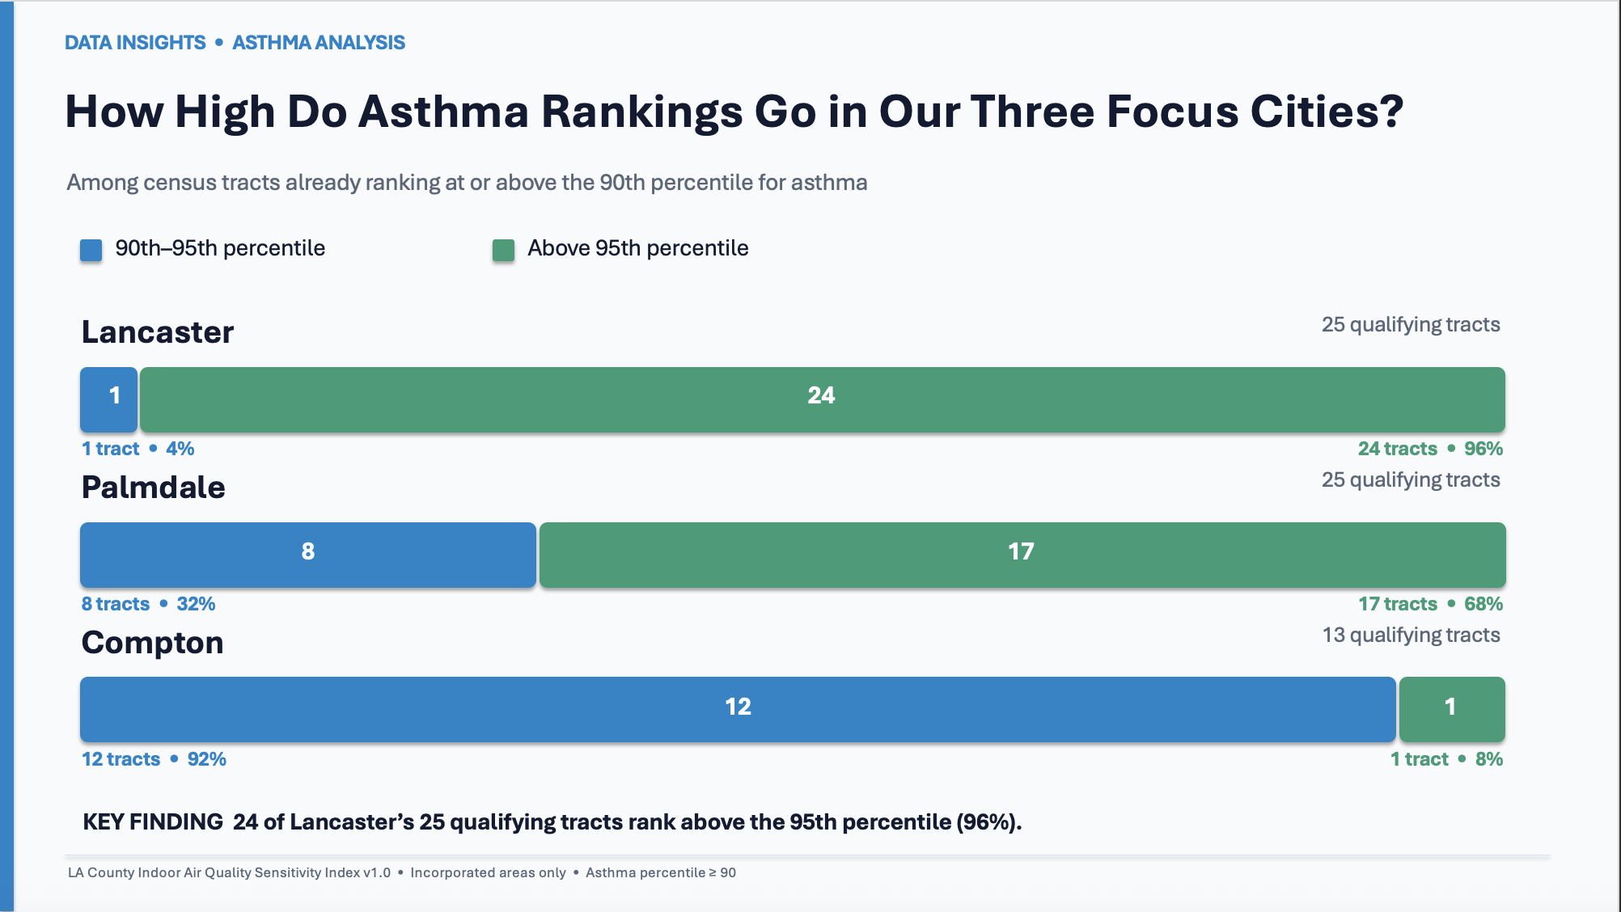

Slide 30
ACTIONABLE STRATEGIES
Policy & Community Interventions
Filtration Upgrades
Facility Monitoring
Healthcare Access
Air quality assessments
HEPA Retrofits: Subsidize filters for older rental units.
Buffer Zones: Prevent industrial siting near homes.
Mobile Screening: Free respiratory clinics in hotspots.
Homes and community facilities:
Develop a referral program for voluntary assessments of ventilation, moisture, mold, and other indoor environmental concerns in higher-priority areas.
School Air Systems: Protect students along freight corridors.
Fenceline Sensors: Real-time alerts for toxic releases.
Multilingual Alerts: Translated air quality hazard notices.
Community Led Air Quality Forum
Create an Environmental Health Equity Funding Formula
Track Community Outcomes Over Time
Partner with residents, neighborhood councils, and local nonprofits to gather concerns about indoor air, housing conditions, and nearby pollution sources.
Encourage agencies to consider multiple indicators of vulnerability when allocating grants for home repairs, community health programs, or environmental
Repeat the analysis as new data becomes available and monitor changes in housing conditions, health indicators, socioeconomic measures, and environmental burdens
Notes:
we identified a few other strategies that could help address environmental health disparities across Los Angeles County.
jaz
First, filtration upgrades would help improve indoor air quality in homes and schools. For example, subsidies for HEPA filters could make filtration more affordable for residents in older rental units, while improving school air systems could help protect students, especially those attending schools near freight corridors.
Second, facility monitoring would help communities identify and respond to potential environmental hazards. Establishing buffer zones between industrial facilities and residential areas could help limit exposure to nearby pollution sources. Fenceline sensors could also monitor emissions near industrial sites and provide real-time alerts when toxic releases occur.
Finally, healthcare access is important for communities that may face greater environmental health risks. Offering free mobile respiratory screening clinics in areas of concern could help residents access health evaluations. Providing air quality hazard notices in multiple languages would also help ensure that more residents can understand potential risks and take appropriate precautions.
Cynthia
indoor air quality assessments could help investigate conditions in homes and community facilities, so this would include ventilation issues, moisture, and mold. Since our IAQ Sensitivity Index measures potential vulnerability rather than directly measuring indoor pollution, these assessments would help determine what problems actually exist in specific locations.
community-led air quality planning would involve working directly with residents, neighborhood councils, and local organizations. Our data helps identify communities that may be experiencing overlapping vulnerabilities, but residents can provide context about local conditions that may not appear in countywide data.
Arsh
Third, equity-based resource allocation could help agencies consider multiple indicators when deciding where to direct funding for environmental assessments, housing improvements, and community health programs. Our analysis showed that educational disadvantage and unemployment do not always rank equally across communities, so relying on just one indicator could overlook certain needs.
Finally, tracking community outcomes over time would allow agencies to repeat this analysis as new data becomes available and see how environmental, housing, health, and socioeconomic conditions change. This would help identify whether conditions are improving and where further investigation may be needed.
Together, these strategies aim to reduce exposure, improve access to health resources, and help communities make more informed decisions about their environmental health.

Slide 31
NEXT STEPS & INQUIRIES
Expanding Our Research Analysis

Slide 32
DATA INSIGHTS •
Limitations and future questions
Limitations
Future Questions
Analysis identifies associations, not causes
What explains the multi-pollutant areas?
Census-tract averages can hide differences within communities
What else drives health issues?
Notes:
There are two important limitations to keep in mind when interpreting our findings. First, our analysis identifies associations between indoor air quality sensitivity and socioeconomic factors, but it does not prove that one causes the other. These patterns can help us identify communities that may need additional attention, but further research would be needed to understand the underlying causes.
Second, our analysis uses census-tract averages, which can hide differences between households and individuals within the same community. For example, some residents may experience more housing-related or indoor air quality challenges than others, even if their census tract has a moderate overall ranking. Because of these limitations, our findings should be used as a starting point for further investigation, alongside more detailed local data and input from community members.
What explains the multi-pollutant areas?
Determine why 63 communities have more than 1 high pollutant and why the city of Compton has 4 high pollutants.
What else drives health issues?
Test other factors that may lead to high levels of asthma or cardiovascular disease other than age and pollutants.

Slide 33
Thank You!

